Slide 1



KEC – IDEATHON 2021
Title : DIGITAL FOOTBALL SCORER
Team Members :-
JAINTH.A 20CSR077 (CSE-B) (II)
GUGHAN.R 20CSR069 (CSE-B) (II)
LOGESHWARAN.A 20CSR109 (CSE-B) (II)
KEERTHI.J 20CSR095 (CSE-B) (II)
Mentor Name , Designation and Department:
Santhoshkumar.S ,AP(SRG) , CSE

Slide 2

Solution Title : FOOTBALL SCORER
Theme : OTHERS
Problem Statement and time frame:
In local Football matches there is no proper maintainance of the database of the previous matches.
It is difficult for the local football match host to update the upcoming tournaments/matches to all the club and teams.
The statistics of the player performance in a match cannot be viewed after the match .
A sudden changes in the fixtures may cause even the players to miss the match.
The third-party viewers (fans who are not at the match) cannot view the scores and statistics .
The identities of local football players are hidden .
Without any database it is hard to hire a player to the team.
Selection of player by trails is hard for the player and also the team management .

Slide 3

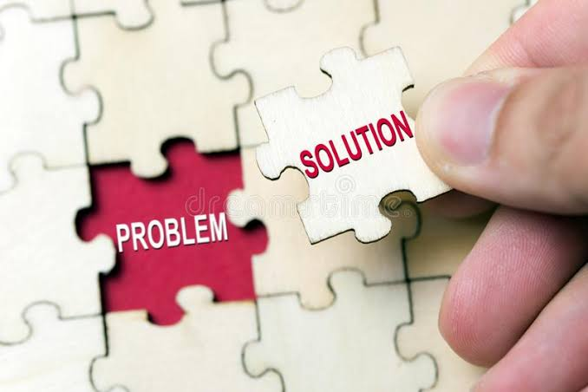
Brief Summary of your solution
It will maitain the database of the each and every player and the every match played .
The third-party can also view the score update of the on going match
(Anywhere and Anytime)
The team management can hire the player by the database
It saves time and energy.
It is a simply application that can be accesed by anyone.
Turfs and organisations can advertise their upcoming tournaments on the app, and users can register for the tournaments using the app.
Fixtures will be posted on the app, so that the fans/followers and the players can arrive on time for the match.
Comment section will be there during live matches
Approach & tech:
To develop a application that stores the database of the each and every matches played and the performance of the player .
The tournament/match organisers will be given an admin login, so that they can update the scores in real time.
To maintain the database and not get duplicate player entries, we’ll be using the Aadhar number as a primary key for the database. The Aadhar card details will also be used while the user is registering for a tournament (To check if they are in the right age group).

Slide 4
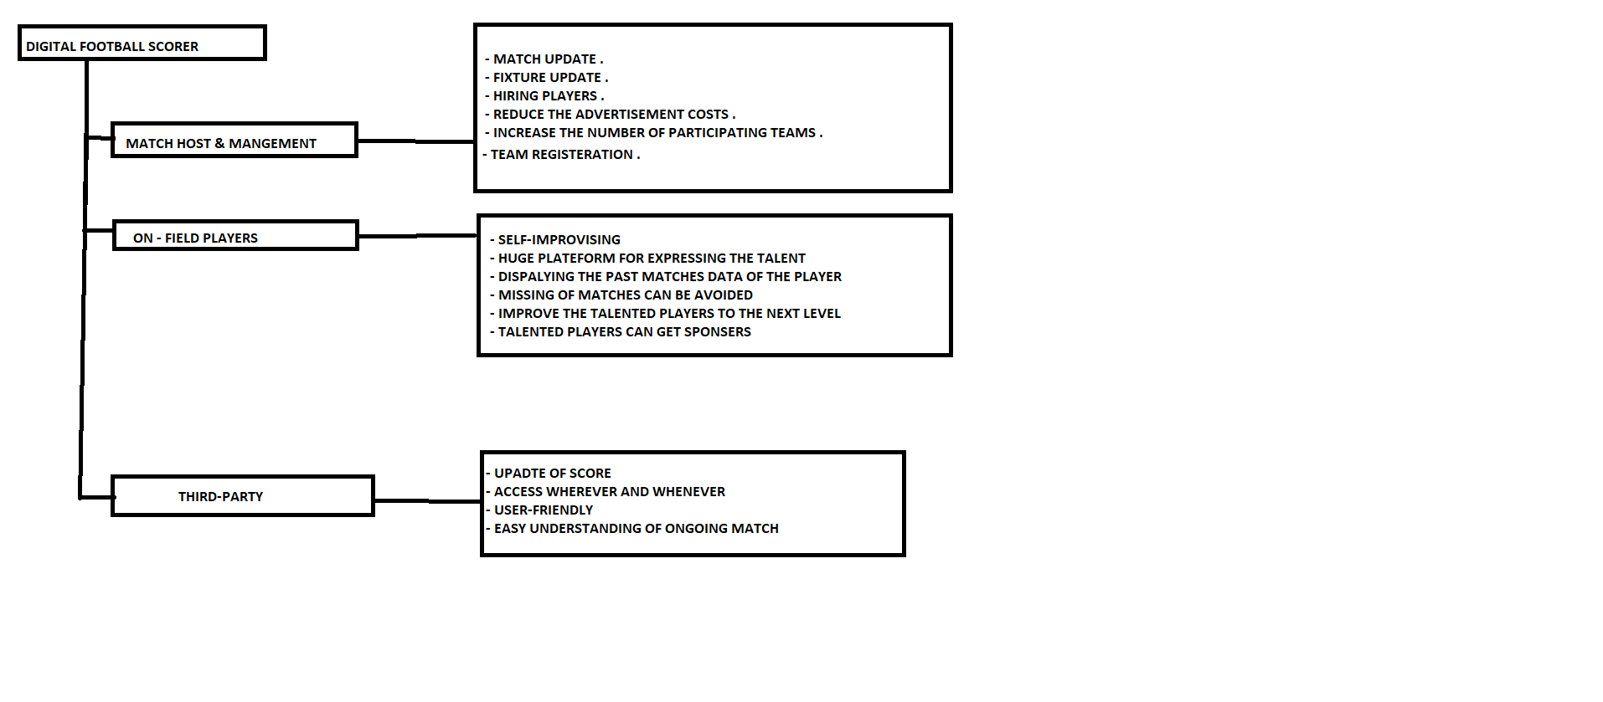
How can your solution help to improve the current situation?

Slide 5
CURRENT
AFTER
In local Football matches there is no proper maintainance of the database of the previous matches.
It is difficult for the local football match host to update the upcoming match to all the club and teams.
The performance of the player in match cannot be viewed after the match . This comes as a blockage for the player to gain the right exposure.
Sudden fixture changes may lead to confusion among the players and viewers.
The third-party (one who is not in the ground at the match -time) cannot view the scores and statistics .
The identity of local football player are hidden
Without any database it is hard to hire a player to the team.
Selection of player by trails is hard for the player and also the team management .
It help to maitain the database of the each and every player and the every matches played .
It helps the team management to update the upcoming match in application , so that every players can get the update of the upcoming. This increases the oppurtunity of the players to show their talents .
The info of the player match helps the player to gain exposure. It helps him/her to move to the next level.
The fixture update is also an option in the application , so the team can be at the time of the match (Missing the match can be avoided) .
The third-party can also view the score update of the on going match (Anywhere and Anytime) .
The team management can hire the player by the database
It saves time and energy.
It is a simply application that can be accesed by anyone.

Slide 6

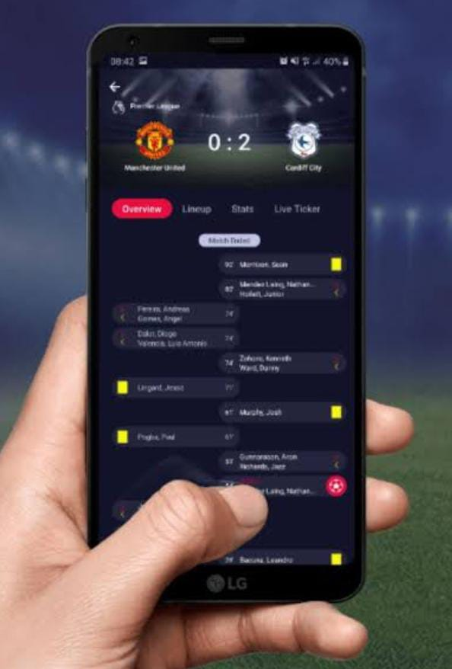
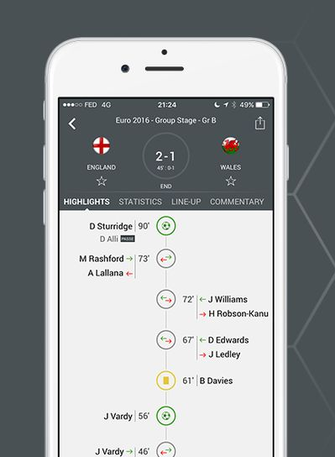
Overview with diagram
Market Size & Business Model
Serviceable Addressable Market
Profit Generation:
A small percentage of the tournament registration fee will be charged (For services that include but not limited to advertisement, online registration and to display the live score).

Slide 7
Business Model Canvas for “DIGITAL SCORER”
Problem / Need
Solution
Unique Value Proposition
Revenue Streams
Customer Segments
There is no proper database for the local matches.
The players performance cannot be visualized after a match ends.
Third party viewers cannot follow the match if they are not able to attend the match.
Tournament hosting and advertising is hard for the conductors.
Sudden fixture changes confuses everyone.
FOR THE LOCAL MATCHES.
THERE IS NO PROPER DATABASE FOR THE LOCAL MATCHES.
THERE IS NO PROPER DATABASE FOR THE LOCAL MATCHES.
THERE IS NO PROPER DATABASE FOR THE LOCAL MATCHES.
THERE IS NO PROPER DATABASE FOR THE LOCAL MATCHES.
THERE IS NO PROPER DATABASE FOR THE LOCAL MATCHES.
THERE IS NO PROPER DATABASE FOR THE LOCAL MATCHES.
THERE IS NO PROPER DATABASE FOR THE LOCAL MATCHES.
THERE IS NO PROPER DATABASE FOR THE LOCAL MATCHES.
THERE IS NO PROPER DATABASE FOR THE LOCAL MATCHES.
THERE IS NO PROPER DATABASE FOR THE LOCAL MATCHES.
THERE IS NO PROPER DATABASE FOR THE LOCAL MATCHES.
THERE IS NO PROPER DATABASE FOR THE LOCAL MATCHES.
THERE IS NO PROPER DATABASE FOR THE LOCAL MATCHES.
THERE IS NO PROPER DATABASE FOR THE LOCAL MATCHES.
THERE IS NO PROPER DATABASE FOR THE LOCAL MATCHES.
THERE IS NO PROPER DATABASE FOR THE LOCAL MATCHES.
THERE IS NO PROPER DATABASE FOR THE LOCAL MATCHES.
THERE IS NO PROPER DATABASE FOR THE LOCAL MATCHES.
THERE IS NO PROPER DATABASE FOR THE LOCAL MATCHES.
THERE IS NO PROPER DATABASE FOR THE LOCAL MATCHES.
THERE IS NO PROPER DATABASE FOR THE LOCAL MATCHES.
THERE IS NO PROPER DATABASE FOR THE LOCAL MATCHES.
THERE IS NO PROPER DATABASE FOR THE LOCAL MATCHES.
THERE IS NO PROPER DATABASE FOR THE LOCAL MATCHES.
THERE IS NO PROPER DATABASE FOR THE LOCAL MATCHES.
THERE IS NO PROPER DATABASE FOR THE LOCAL MATCHES.
THERE IS NO PROPER DATABASE FOR THE LOCAL MATCHES.
THERE IS NO PROPER DATABASE FOR THE LOCAL MATCHES.
THERE IS NO PROPER DATABASE FOR THE LOCAL MATCHES.
THERE IS NO PROPER DATABASE FOR THE LOCAL MATCHES.
THERE IS NO PROPER DATABASE FOR THE LOCAL MATCHES.
THERE IS NO PROPER DATABASE FOR THE LOCAL MATCHES.
THERE IS NO PROPER DATABASE FOR THE LOCAL MATCHES.
THERE IS NO PROPER DATABASE FOR THE LOCAL MATCHES.
THERE IS NO PROPER DATABASE FOR THE LOCAL MATCHES.
THERE IS NO PROPER DATABASE FOR THE LOCAL MATCHES.
THERE IS NO PROPER DATABASE FOR THE LOCAL MATCHES.
THERE IS NO PROPER DATABASE FOR THE LOCAL MATCHES.
THERE IS NO PROPER DATABASE FOR THE LOCAL MATCHES.
THERE IS NO PROPER DATABASE FOR THE LOCAL MATCHES.
THERE IS NO PROPER DATABASE FOR THE LOCAL MATCHES.
THERE IS NO PROPER DATABASE FOR THE LOCAL MATCHES.
THERE IS NO PROPER DATABASE FOR THE LOCAL MATCHES.
THERE IS NO PROPER DATABASE FOR THE LOCAL MATCHES.
THERE IS NO PROPER DATABASE FOR THE LOCAL MATCHES.
THERE IS NO PROPER DATABASE FOR THE LOCAL MATCHES.
THERE IS NO PROPER DATABASE FOR THE LOCAL MATCHES.
THERE IS NO PROPER DATABASE FOR THE LOCAL MATCHES.
THERE IS NO PROPER DATABASE FOR THE LOCAL MATCHES.
THERE IS NO PROPER DATABASE FOR THE LOCAL MATCHES.
THERE IS NO PROPER DATABASE FOR THE LOCAL MATCHES.
THERE IS NO PROPER DATABASE FOR THE LOCAL MATCHES.
THERE IS NO PROPER DATABASE FOR THE LOCAL MATCHES.
THERE IS NO PROPER DATABASE FOR THE LOCAL MATCHES.
THERE IS NO PROPER DATABASE FOR THE LOCAL MATCHES.
THERE IS NO PROPER DATABASE FOR THE LOCAL MATCHES.
THERE IS NO PROPER DATATHERE IS NO PROPER DATABASE FOR THE LOCAL MATCHES.
IN THE LOCAL MATCHES THEY USE NOTEBOOKS FOR NOTING THE SCORE,HENCE IT IS HARD TO MAITAIN IT FOR LONG PERIOD.
THE PLAYERS PERFORMANCE CAN’T BE VISUALIZED AFTER THE MATCH IN LOCAL MATCHES
THE THIRD PARTY MEMBER CANNOT VIEW THE SCORE OF THE ONGOING MATCH.
THE FOULS CANNOT BE NOTED PROPERLY IN LOCAL MATCHES.
THERE IS NO PROPER DATABASE FOR THE LOCAL MATCHES.
IN THE LOCAL MATCHES THEY USE NOTEBOOKS FOR NOTING THE SCORE,HENCE IT IS HARD TO MAITAIN IT FOR LONG PERIOD.
THE PLAYERS PERFORMANCE CAN’T BE VISUALIZED AFTER THE MATCH IN LOCAL MATCHES
THE THIRD PARTY MEMBER CANNOT VIEW THE SCORE OF THE ONGOING MATCH.
THE FOULS CANNOT BE NOTED PROPERLY IN LOCAL MATCHES.
THERE IS NO PROPER DATABASE FOR THE LOCAL MATCHES.
IN THE LOCAL MATCHES THEY USE NOTEBOOKS FOR NOTING THE SCORE,HENCE IT IS HARD TO MAITAIN IT FOR LONG PERIOD.
THE PLAYERS PERFORMANCE CAN’T BE VISUALIZED AFTER THE MATCH IN LOCAL MATCHES
THE THIRD PARTY MEMBER CANNOT VIEW THE SCORE OF THE ONGOING MATCH.
THE FOULS CANNOT BE NOTED PROPERLY IN LOCAL MATCHES.
BASE FOR THE LOCAL MATCHES.
IN THE LOCAL MATCHES THEY USE NOTEBOOKS FOR NOTING THE SCORE,HENCE IT IS HARD TO MAITAIN IT FOR LONG PERIOD.
THE PLAYERS PERFORMANCE CAN’T BE VISUALIZED AFTER THE MATCH IN LOCAL MATCHES
THE THIRD PARTY MEMBER CANNOT VIEW THE SCORE OF THE ONGOING MATCH.
THE FOULS CANNOT BE NOTED PROPERLY IN LOCAL MATCHES.
ATCHES.
IN THE LOCAL MATCHES THEY USE NOTEBOOKS FOR NOTING THE SCORE,HENCE IT IS HARD TO MAITAIN IT FOR LONG PERIOD.
THE PLAYERS PERFORMANCE CAN’T BE VISUALIZED AFTER THE MATCH IN LOCAL MATCHES
THE THIRD PARTY MEMBER CANNOT VIEW THE SCORE OF THE ONGOING MATCH.
THE FOULS CANNOT BE NOTED PROPERLY IN LOCAL MATCHES.
The database of the players and matches will be maintained.
Live scores and statistics will be displayed
Tournament advertising can be done through the app, giving the tournament a wide exposure.
Online registration for the tournament can be done through the app.
Sudden fixture changes will be uploaded instantly
The football scoring app is only used for international matches, but our idea is to develop an app that can be used by anyone and anywhere.
Tournament host can display their upcoming tournaments in the app.
Tournament registration can be done through the app.
A small percentage of fees from the online registration can be charged, in exchange for the hassle free registration and promotion.
Football Fans
Football Player
Tournament hosts
Turfs/Organizations
Existing alternatives
Unfair Advantage
Early adopters
These problems are being addressed only on an international level with applications like goal.com, onefootball and sofa score.
Local football followers who do not have the time to attend the match, or do not know the fixtures.
Turfs/Organizations who want to conduct a tournament with hassle free registration and promotion.
Data-base of stats of a physical match.
Memorable picture of wining team.
Update on the upcoming matches.
Easily accessed by everyone at anytime.
Key Risks
Key Metrics
Cost Structure
Channels
No. of downloads
No. of tournaments hosted
No. of live followers
Social Risks.
Environment Risks.
Setting of the application
Advertismenting cost.
Application setup cost.
Android and IOS app
Team Name | THE SQUAD | KEC Ideathon

